Slide 1
Blood -phy

Slide 2
Unit 1

Slide 3
Blood
Blood is a specialized connective tissue that circulates through blood vessels and transports essential substances throughout the body.
Blood is a thick, opaque, red-colored fluid with a pH 7.4 and a specific gravity of 1.055 to 1.060
Blood consists of two major components:
Component | Percentage | Description
Plasma | ~55% | Fluid portion containing water, proteins, electrolytes, hormones, nutrients, waste products
Formed Elements | ~45% | Blood cells – RBCs, WBCs, Platelets

Slide 4
Blood
Blood is three to four times thicker than water.
The colloid osmotic pressure of blood is 25 mm Hg.
Blood contributes to 8 % of total body weight.
In a 70 kg adult, the total blood volume is around 5 litres.

Slide 5
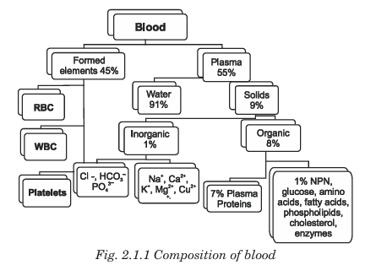
Composition

Slide 6
Plasma – Details
Water – 90–92%
Plasma proteins – 6–8%
  Albumin – maintains osmotic pressure
  Globulins – immunity
  Fibrinogen – blood clotting
Other substances – glucose, amino acids, lipids, hormones, vitamins, urea, electrolytes (Na+, K+, Ca²⁺, Cl⁻)

Slide 7
Plasma proteins
Major Plasma Proteins
There are three main types:
Plasma Protein | Percentage | Produced by | Major Functions
Albumin | ~60% | Liver | Maintains oncotic/osmotic pressure, transport of hormones, drugs, fatty acids
Globulins | ~36% | Liver & Immune cells | Immunity (antibodies), transport proteins
Fibrinogen | ~4% | Liver | Blood clotting, forms fibrin threads

Slide 8
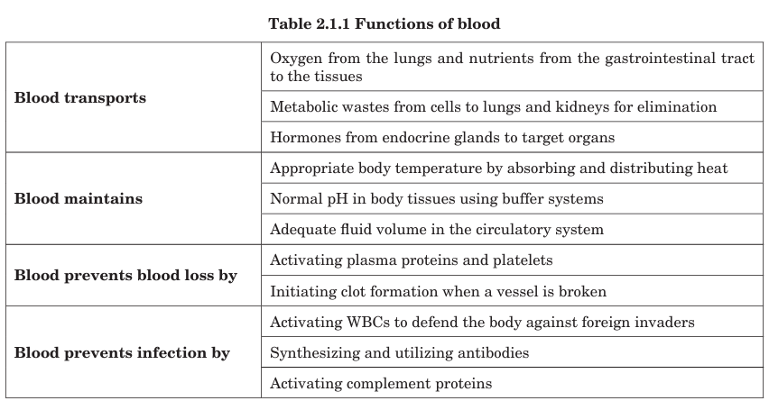

Slide 9
Function | Proteins Involved | Explanation
1. Maintenance of colloid osmotic pressure (COP) | Albumin (main), Globulins | Prevents leakage of fluid from blood to tissues; maintains blood volume and prevents edema
2. Transport function | Albumin, Globulins, Lipoproteins | Transport hormones, bilirubin, fatty acids, drugs, vitamins, metals (iron, copper), etc.
3. Blood clotting / Hemostasis | Fibrinogen, Prothrombin, Clotting factors | Essential in formation of fibrin clot to stop bleeding
4. Immunity / Defense | γ-Globulins (Immunoglobulins) | Antibodies neutralize pathogens and provide immune protection
5. Buffering (Acid–base balance) | Albumin (main), Globulins | Proteins act as buffers and help maintain blood pH (7.35–7.45)
6. Maintenance of blood viscosity | All plasma proteins | Responsible for thickness of blood → affects blood flow and blood pressure
7. Storage / Reserve of amino acids | Albumin and Globulins | Acts as protein reserve; can be broken down during starvation/malnutrition
8. Carrier of drugs | Albumin | Binds many drugs and controls their availability and action in the body
9. Role in erythrocyte sedimentation rate (ESR) | Fibrinogen & Globulins ↑ ESR | Increased levels cause RBCs to sediment faster, used diagnostically
10. Tissue nutrition | All plasma proteins | Supply amino acids for cell growth and repair

Slide 10
Applied aspects
Edema in liver failure, kidney disease and malnutrition is due to hypoproteinemia which results in decreased colloid osmotic pressure.
In hepatic insufficiency, there is relative gamma globulinemia. α1 antitrypsin deficiency leads to emphysema; Transferrin deficiency occurs in iron deficiency anemia; Ceruloplasmin deficiency leads to Wilson’s disease.
C reactive protein (CRP) is raised in inflammatory conditions.
Certain plasma proteins can be used as tumor markers: Carcinoembryonic antigen (CEA) is the marker for cancer of bowel, stomach and lung, and alpha fetoprotein (α FP) is the marker for cancer liver and testicular tumor

Slide 11
Unit 2

Slide 12
Red blood corpuscles
RBC (Red Blood Cell), also called Erythrocyte, is the most abundant type of blood cell that is mainly responsible for the transport of oxygen and carbon dioxide in the body.
RBCs contain hemoglobin, an iron-containing pigment that binds with oxygen and gives blood its red color.
Morphology
Shape: Biconcave disc
Diameter: ~7.2 – 7.8 µm
Thickness: ~2.2 µm at periphery, 1 µm at center
Nucleus: Absent in mature RBCs (non-nucleated)
Organelles: No mitochondria, no Golgi body (allows more space for hemoglobin)

Slide 13
Red blood corpuscles
Normal Values
Parameter | Normal Value
RBC Count | 5–6 million/µL in males; 4–5 million/µL in females
Hemoglobin | 13–18 g/dL (males), 11–16 g/dL (females)
Life Span | 120 days
Production site | Red bone marrow
Destruction site | Spleen, liver, bone marrow (spleen = graveyard of RBCs)

Slide 14
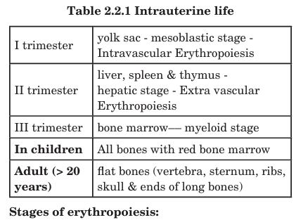
Erythropoiesis
Erythropoiesis is defined as the production and maturation of erythrocytes.
Erythropoiesis begins with a pluripotent stem cell whose progeny is influenced by hormones to develop into several cell lines.
One of these cell lines becomes committed to the erythroid line of development

Slide 15
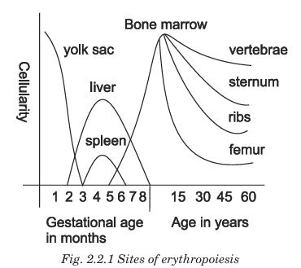
Total period of erythropoiesis- 7-9 days

Slide 16
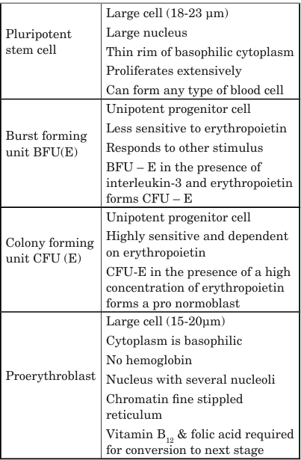
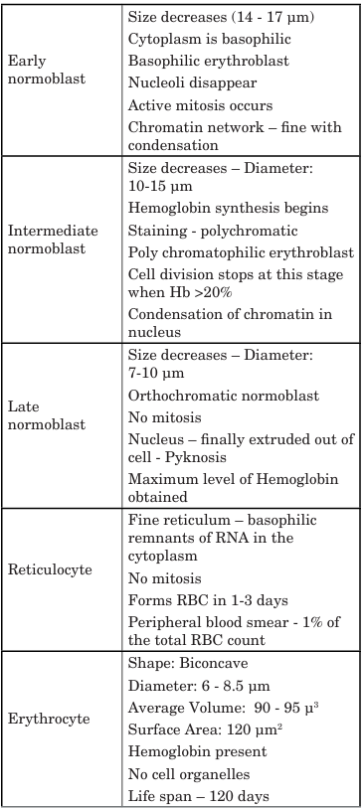

Slide 17
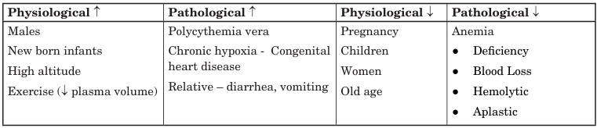
Normal values of RBC Count
In males, average RBC count is 5.4 million cells/ cu.mm; in females, it is 4.8 million cells/cu.mm and in newborns, it is greater.

Slide 18
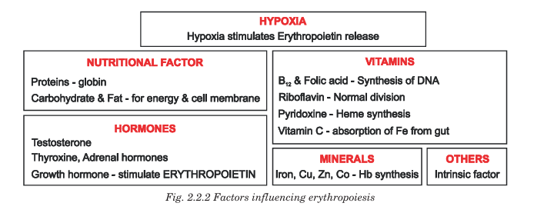

Slide 19
Factors influencing erythropoiesis
1. Hormonal Factors
Hormone | Function
Erythropoietin (EPO • main regulator) | Stimulates RBC production in bone marrow during hypoxia
Thyroxine | Increases tissue metabolism → increases RBC demand
Growth hormone | Promotes RBC formation
Androgens (Testosterone) | Strong stimulators of RBC production
Cortisol | Enhances RBC maturation

Slide 20
Factors influencing erythropoiesis
2. Nutritional Factors
Nutrient | Role in RBC formation
Iron | Synthesis of hemoglobin
Vitamin B12 | DNA synthesis of RBCs
Folic acid | DNA synthesis and cell division
Protein | Building material for hemoglobin and RBC stroma
Vitamin B6 (Pyridoxine) | Heme synthesis
Copper & Cobalt | Assist iron utilization and RBC production
Vitamin C | Enhances iron absorption

Slide 21
Factors influencing erythropoiesis
3. Physiological Factors
Factor | Effect
Hypoxia | Primary stimulus → increases EPO secretion
Exercise & high altitude | Increase oxygen demand → ↑ RBC production
Age | Erythropoiesis highest in infancy & childhood
Gender | Higher in males (due to testosterone)

Slide 22
Factors influencing erythropoiesis
5. Nervous System & Temperature
Factor | Effect
Sympathetic stimulation | Enhances erythropoiesis during stress
Body temperature | High temperature increases RBC production

Slide 23
Factors influencing erythropoiesis
4. Bone Marrow Health
Condition | Effect
Healthy red bone marrow | Normal erythropoiesis
Bone marrow disease / fibrosis / radiation | ↓ RBC production → anemia

Slide 24
Applied aspects
Reduction in RBC count and hemoglobin content or presence of abnormal hemoglobin may decrease the oxygen carrying capacity of blood, leading to hypoxia and various clinical consequences. Anemia is due to quantitative/qualitative decrease in RBC count, Hb content and hematocrit. Anemia is classified into various types based on the etiology and the morphology. The clinical features of anemia include: Pallor of the nail beds, skin, conjunctiva and mucous membrane, tiredness, easy fatigability, general muscular weakness, dyspnea on exertion, palpitation, cardiac murmurs and amenorrhea.
Polycythemia is a condition in which there is either an absolute or relative increase in RBC count. Absolute polycythemia is either primary and is called polycythemia vera or could be (i) Secondary to inappropriate increase in erythropoietin secretion (kidney tumor, liver tumor, pheochromocytoma) (ii) Secondary to tissue hypoxia (high altitude, coronary heart disease, chronic pulmonary disease) and (iii) Secondary to hormonal stimulus (Cushing’s syndrome). Relative polycythemia occurs when there is decrease in plasma volume with normal RBC count as in dehydration. Increase in RBC count results in increased blood viscosity.

Slide 25
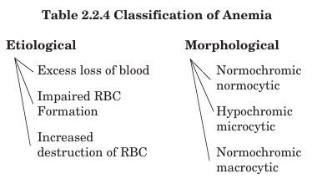
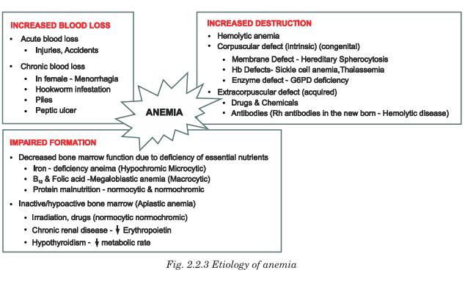

Slide 26
Unit 3

Slide 27
White blood corpuscles
WBC (White Blood Cells), also called Leukocytes, are the cells of blood that are primarily responsible for the defense and protection of the body against infections, foreign particles, and diseases. They are an important part of the immune system.
Unlike RBCs, WBCs are nucleated and do not contain hemoglobin.
Morphology
Shape: Irregular / Amoeboid
Size: Larger than RBCs (10–20 µm on average)
Nucleus: Present (single or multilobed depending on type)
Organelles: Present
Movement: Show Amoeboid movement and can migrate out of blood vessels (diapedesis)

Slide 28
White blood corpuscles
Normal Values
Parameter | Normal Value
Total WBC Count | 4,000 – 11,000 / µL of blood
Life Span | Few hours to many years (depending on type)
Production Site | Red bone marrow and lymphoid tissues

Slide 29
Classification of WBCs
1. Granulocytes
(Have granules in cytoplasm; lobed nucleus)
1. Granulocytes
(Have granules in cytoplasm; lobed nucleus)
Type | Percentage | Function
Neutrophils | 50–70% | First line of defense → phagocytosis of bacteria
Eosinophils | 2–4% | Allergic reactions, parasitic infections
Basophils | 0–1% | Release histamine & heparin → inflammatory response

Slide 30
Classification of WBCs
1. Agranulocytes
(No granules; large nucleus))
1. Granulocytes
(Have granules in cytoplasm; lobed nucleus)
2. Agranulocytes
(No granules; large nucleus)
Type | Percentage | Function
Lymphocytes | 20–40% | Immunity (T cells, B cells, NK cells)
Monocytes | 2–8% | Become macrophages → phagocytosis of microbes & dead cells

Slide 31
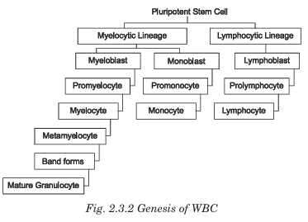

Slide 32
Neutrophils
Structure of Neutrophils
the most abundant WBCs and the first line of defense against infections.
Feature | Description
Shape | Spherical in blood; irregular after activation
Size | 10 – 14 µm
Nucleus | Multilobed nucleus (3–5 lobes) → “Polymorphonuclear leukocyte (PMN)”
Cytoplasm | Pale cytoplasm containing fine granules
Granules | Primary (azurophilic) and secondary granules
Organelles | Lysosomes, mitochondria, Golgi, ribosomes present
Movement | Shows amoeboid movement
Migration | Can exit blood vessels to tissues via diapedesis

Slide 33
Neutrophils
Functions of Neutrophils
the most abundant WBCs and the first line of defense against infections.
No. | Function | Description
1 | Phagocytosis | Engulf and destroy bacteria and foreign particles
2 | Release of enzymes | Granules contain lysosomal enzymes that digest microbes
3 | Production of reactive oxygen species (ROS) | “Respiratory burst” kills pathogens
4 | Formation of NETs (Neutrophil Extracellular Traps) | DNA + proteins trap and kill microbes outside the cell
5 | Inflammatory response | Secrete cytokines to recruit and activate other immune cells
6 | First responder to infection | Arrive rapidly at sites of injury/infection

Slide 34
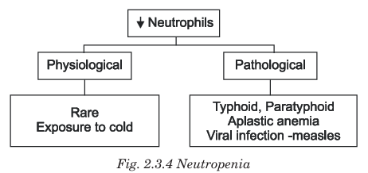
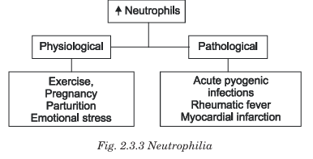
Neutrophils pathology of Neutrophils
the most abundant WBCs and the first line of defense against infections.

Slide 35
Eosinophils
Structure of Eosinophils
the most abundant WBCs and the first line of defense against infections.
Feature | Description
Shape | Spherical in blood; irregular in tissues
Size | 10 – 15 µm
Nucleus | Bilobed nucleus (2 lobes)
Cytoplasm | Filled with large coarse eosinophilic granules (orange-red with eosin stain)
Granules | Contain major basic protein (MBP), eosinophil cationic protein, peroxidase
Movement | Show amoeboid movement
Life span | 8–12 days in tissues

Slide 36
Eosinophils functions of Eosinophils
the most abundant WBCs and the first line of defense against infections.
No. | Function | Description
1 | Defense against parasites (helminths) | Release toxic proteins—especially major basic protein (MBP)—to kill parasites
2 | Role in allergic reactions | Control allergic responses by neutralizing histamine and inflammatory mediators
3 | Phagocytosis (limited) | Engulf antigen-antibody complexes
4 | Modulation of inflammation | Secrete enzymes that reduce excessive inflammation
5 | Detoxification | Detoxify substances released during allergic reactions and infection

Slide 37
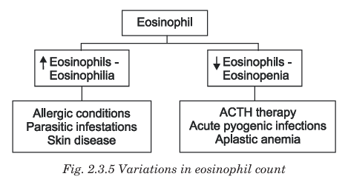
Eosinophils pathology of Eosinophils
the most abundant WBCs and the first line of defense against infections.

Slide 38
Basophils structure of basophils
the most abundant WBCs and the first line of defense against infections.
Feature | Description
Shape | Round cell
Size | ~12–15 µm
Nucleus | Bilobed or S-shaped nucleus (usually obscured by granules)
Cytoplasm | Contains large, coarse basophilic granules (blue-purple with basic dyes)
Granules contain | Histamine, Heparin, Serotonin, Leukotrienes, and Proteases
Surface receptors | Have IgE receptors on the cell membrane
Life span | Few hours in blood → survives for days in tissues

Slide 39
Basophils functions of basophils
the most abundant WBCs and the first line of defense against infections.
No. | Function | Description
1 | Allergic reactions | Release histamine leading to vasodilation and increased vascular permeability → swelling, redness
2 | Anticoagulant action | Heparin prevents blood clotting locally
3 | Hypersensitivity (Type I reactions) | IgE-antigen binding triggers granule release → anaphylaxis, asthma
4 | Inflammation mediation | Release leukotrienes and prostaglandins to enhance inflammation
5 | Defense against bacteria | Support other WBCs in immune responses (limited phagocytosis)

Slide 40
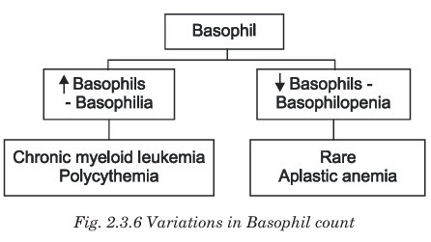
Basophils pathology of basophils
the most abundant WBCs and the first line of defense against infections.

Slide 41
Lymphocyte structure of lymphocyte
the most abundant WBCs and the first line of defense against infections.
Feature | Description
Shape | Spherical cell
Size | 7–15 µm (small and large types)
Nucleus | Large round nucleus occupying most of the cell
Cytoplasm | Thin rim of pale blue cytoplasm (non-granular)
Organelles | Ribosomes, mitochondria and lysosomes present
Types | T-lymphocytes, B-lymphocytes, Natural Killer (NK) cells
Life span | Months to many years (longest living WBCs)

Slide 42
Lymphocyte functions of lymphocyte
the most abundant WBCs and the first line of defense against infections.
Type of Lymphocyte | Major Function | Description
T-Lymphocytes | Cell-mediated immunity | Attack virus-infected cells, cancer cells; regulate immune system
B-Lymphocytes | Humoral immunity | Produce antibodies (become plasma cells)
Natural Killer (NK) Cells | Nonspecific defense | Destroy tumor cells and virus-infected cells without prior sensitization

Slide 43
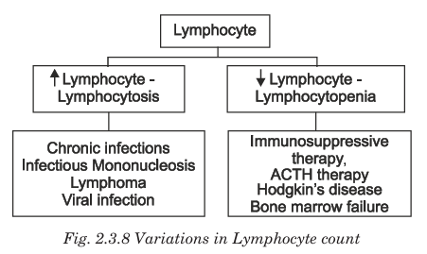
Lymphocyte pathology of lymphocyte
the most abundant WBCs and the first line of defense against infections.

Slide 44
Monocyte structure of monocyte
the most abundant WBCs and the first line of defense against infections.
Feature | Description
Size | 12–20 µm (largest WBC)
Nucleus | Large kidney-shaped / bean-shaped nucleus
Cytoplasm | Abundant gray-blue cytoplasm, may contain vacuoles
Granules | No specific granules (agranulocyte), but have lysosomal enzymes
Organelles | Rich in lysosomes, mitochondria, and Golgi apparatus
Life span | 1–3 days in blood → months in tissues
Tissue form | Macrophages (monocytes migrate into tissues and transform)

Slide 45
Monocyte functions of monocyte
the most abundant WBCs and the first line of defense against infections.
Function | Description
Phagocytosis | Engulf and destroy microbes, dead cells, and debris
Antigen presentation | Process antigens and present them to T-lymphocytes to initiate immune response
Cytokine secretion | Release IL-1, TNF-α and other cytokines to regulate inflammation
Differentiate into macrophages | Become tissue macrophages (Kupffer cells, microglia, alveolar macrophages etc.)
Tumor and virus defense | Kill cancer cells and virus-infected cells through cytotoxic molecules

Slide 46
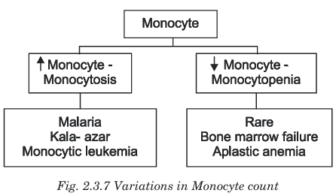
Monocyte pathology of monocyte
the most abundant WBCs and the first line of defense against infections.

Slide 47
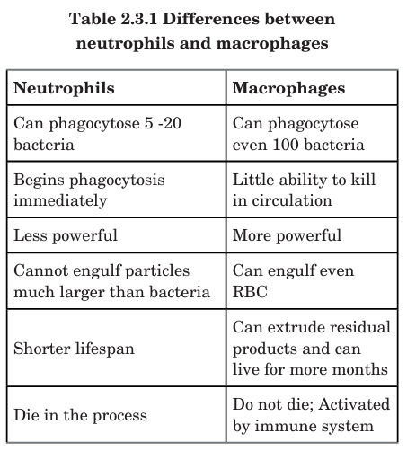

Slide 48
Lymphatic System
The lymphatic system is a network of lymphatic vessels, lymph nodes and lymphoid organs that helps in maintaining body fluid balance and immunity.
Main Components
Component | Description
Lymph | Tissue fluid that flows inside lymphatic vessels
Lymphatic vessels | Thin tubes that collect excess tissue fluid and return it to blood
Lymph nodes | Small bean-shaped structures that filter lymph and destroy microbes
Lymphoid organs | Thymus, spleen, tonsils, bone marrow, Peyer’s patches etc.

Slide 49
Lymphatic system
Functions of Lymphatic System
Maintain fluid balance by returning excess tissue fluid to bloodstream
Defense against infection through lymph nodes and lymphocytes
Absorption of fats from intestine via lacteals (lymph capillaries) in villi
Transport of immune cells throughout the body
Removal of waste substances and dead cells

Slide 50
Lymph
Lymph is a clear, pale-yellow fluid circulated in the lymphatic system.
It is similar to plasma but contains more lymphocytes and less proteins.
Composition of Lymph
Water
Plasma proteins (low amount)
Lymphocytes (very high)
Fats (chylomicrons)
Electrolytes and waste products
Formation of Lymph
Blood plasma filters out through capillaries → becomes tissue fluid → excess tissue fluid enters lymphatic capillaries → becomes lymph.

Slide 51
Functions of lymph
Function | Explanation
Returns excess tissue fluid to blood | Prevents edema
Immunity | Carries lymphocytes and antibodies
Fat absorption | Transports fat from intestine to blood
Transport | Moves hormones, nutrients and waste materials

Slide 52
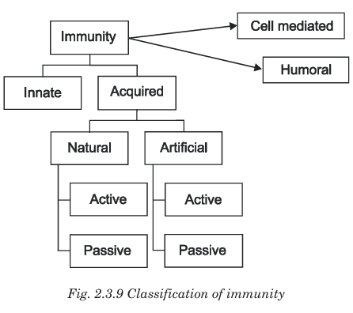

Slide 53
Unit 4

Slide 54
Platelets (Thrombocytes) – Introduction
Platelets are small, non-nucleated, disc-shaped cell fragments present in blood that play a major role in blood clotting (hemostasis).
Origin: Bone marrow
Produced from: Megakaryocytes (fragments of cytoplasm)
Count: 1.5 – 4 lakhs/mm³ of blood
Lifespan: 8 – 12 days
Removed by: Spleen and liver

Slide 55
Structure of platelet
Feature | Description
Size | 2–4 µm
Shape | Disc-shaped
Nucleus | Absent (non-nucleated)
Cytoplasm | Granular cytoplasm with alpha granules and dense granules
Membrane | Contains receptors and phospholipids needed for clotting

Slide 56
Functions of platelets
Function | Explanation
1. Hemostasis (Prevention of blood loss) | Platelets are the primary cells responsible for stopping bleeding when a blood vessel is injured.
2. Platelet Plug Formation | Platelets adhere to damaged vessel walls and aggregate to form a temporary platelet plug that seals the wound.
3. Blood Clotting (Coagulation) | Platelets release clotting factors and provide a surface for reactions that convert fibrinogen → fibrin, leading to a stable blood clot.
4. Release of Chemical Mediators | Dense granules release ADP, Ca²⁺ and serotonin which help in platelet activation, aggregation and vasoconstriction.
5. Vasoconstriction | Platelets release serotonin, causing constriction of blood vessels, reducing blood flow and minimizing blood loss.
6. Wound Healing and Tissue Repair | Platelets release platelet-derived growth factor (PDGF) which promotes growth of fibroblasts and smooth muscle cells to repair damaged tissue.
7. Immune Role (Secondary) | Platelets can trap and destroy microbes and support inflammatory responses through cytokine release.

Slide 57
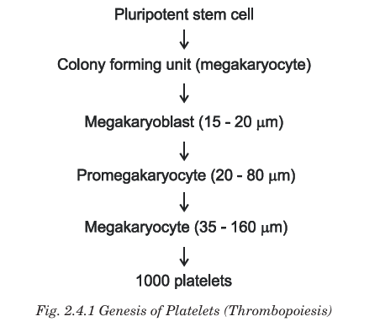

Slide 58
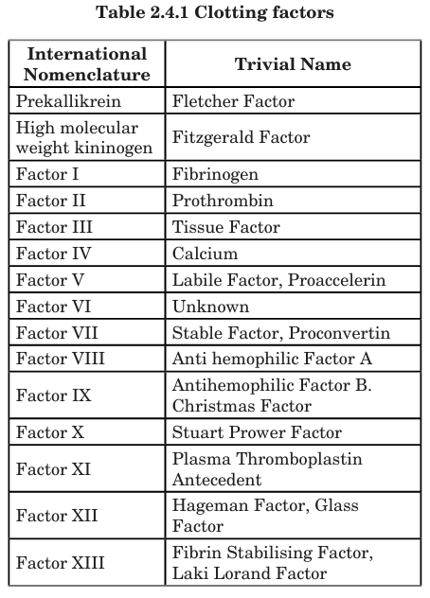
Clotting mechanism

Slide 59
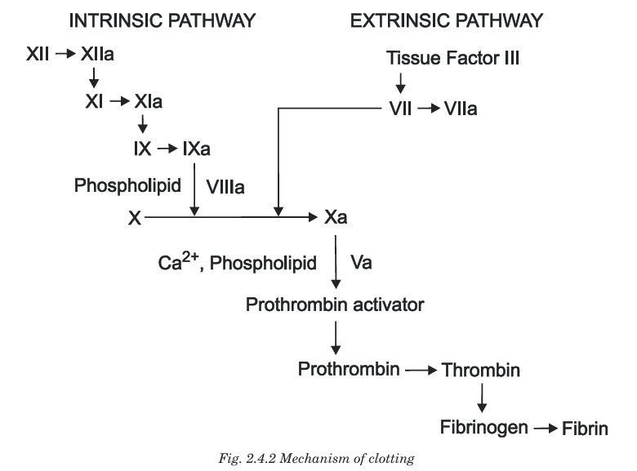

Slide 60
Anticoagulant
Anticoagulants are substances that prevent blood coagulation (clotting) by inhibiting the clotting factors or blocking platelet activities.
They are also called blood thinners, although they do not really make blood thinner — they only delay clot formation.
Mechanism of Action
Anticoagulants prevent clotting by:
Inhibiting clotting factors
Blocking calcium (Ca²⁺) required for clotting
Enhancing natural anticoagulants
Inhibiting platelet aggregation

Slide 61
Applied aspects
1. Thrombocytopenia (Low Platelet Count)
Platelet count < 1.5 lakh/mm³
Causes → Bone marrow failure, viral infections (Dengue), chemotherapy, autoimmune disorders
Features → Excessive bleeding, petechiae, bruises, nosebleeds, bleeding gums
Severe thrombocytopenia (< 20,000/mm³) → high risk of internal bleeding
2. Thrombocytosis (High Platelet Count)
Platelet count > 4.5 lakh/mm³
Causes → Chronic inflammation, infections, cancer, splenectomy
Risk → Unwanted clot (thrombosis) which can lead to:
  Stroke
  Heart attack
  Deep vein thrombosis (DVT)

Slide 62
Applied aspects
3. Platelet Dysfunction (Normal count but abnormal function)
Seen in Aspirin therapy, kidney failure, hereditary disorders
Platelets fail to aggregate → Bleeding tendency
Aspirin inhibits platelet aggregation by blocking Thromboxane A₂ → used in preventing heart attacks and strokes
4. Platelet Transfusion
Used in patients with:
  Severe thrombocytopenia
  Bone marrow suppression
  Dengue hemorrhagic fever
  Major surgery or trauma with active bleeding
Helps prevent bleeding by raising platelet numbers quickly

Slide 63
Applied aspects
5. Role in Cardiovascular Diseases
Excess platelet activation → blood clot formation → coronary artery blockage
Drugs used to prevent platelet clots:
  Aspirin
  Clopidogrel
  Ticagrelor
These are called antiplatelet drugs
6. Platelet Storage
Stored at 22°C (room temperature) with continuous shaking
Shelf-life: 5–7 days
Widely used in blood banks and oncology patients

Slide 64
Unit 5

Slide 65
Blood banking and transfusion reactions
A knowledge about blood group systems is essential for the following:
in blood transfusions;
tissue matching in organ transplantation;
resolving paternity disputes; prevention of Rh incompatibility;
identification of criminals in forensic medicine and research

Slide 66
Blood group system
Blood group systems are classifications of blood based on specific antigens present on the surface of red blood cells (RBCs).
These antigens determine compatibility for blood transfusion and immune reactions.
There are more than 30 blood group systems

Slide 67
1. ABO Blood Group System
This system was discovered by Karl Landsteiner.
Transfusion Importance (Universal)
O negative → Universal donor
AB positive → Universal recipient
Blood Group | RBC Surface Antigen | Plasma Antibody
A | Antigen A | Anti-B
B | Antigen B | Anti-A
AB | Antigen A + B | None
O | None | Anti-A + Anti-B

Slide 68
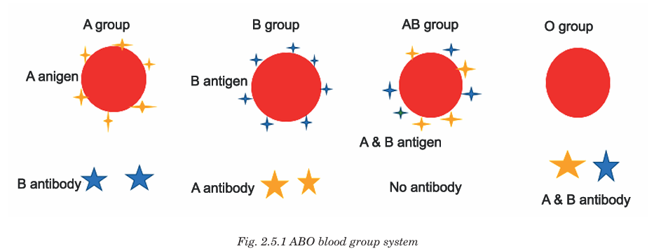

Slide 69
2. Rh Blood Group System
Based on the presence of Rh antigen (D antigen) on RBCs:
Clinical Importance
Rh⁻ person receiving Rh⁺ blood → forms anti-D antibodies
In pregnancy, Rh incompatibility can cause Erythroblastosis fetalis (hemolytic disease of newborn)
Rh Type | Description
Rh positive (Rh⁺) | D antigen present
Rh negative (Rh⁻) | D antigen absent

Slide 70
Landsteiner’s law
Landsteiner’s Law describes the relationship between antigens on RBCs and antibodies in plasma in the ABO blood group system.
Landsteiner’s Law States:
1️⃣ If an antigen is present on the RBC membrane, the corresponding antibody will be absent in the plasma.
2️⃣ If an antigen is absent on the RBC membrane, the corresponding antibody will be present in the plasma.

Slide 71
